Slide 1
UNIT-II
LOGIC FAMILIES

Slide 2
IC digital logic families
IC digital logic families
-- DL(Diode-logic)
RTL(Resistor-transistor logic）
DTL(Diode-transistor logic）
TTL(Transistor -transistor logic）
ECL(Emitter-coupled logic）
CMOS(Complementary Metal-oxide semiconductor）

Slide 3
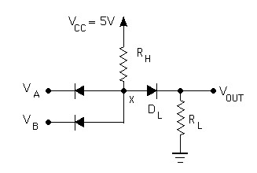

Diode Logic (DL)
simplest; does not scale
NOT not possible (need an active element)
A | B | AND o/p
0 | 0 | 0
0 | 1 | 0
1 | 0 | 0
1 | 1 | 1
=

Slide 4
Resistor-Transistor Logic (RTL)
O/p voltage drops about 1v when the fan-out is 5
Power dissipation is about 12mw.
Propagation delay averages 25ns.

Slide 5
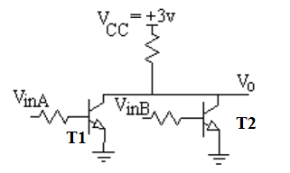
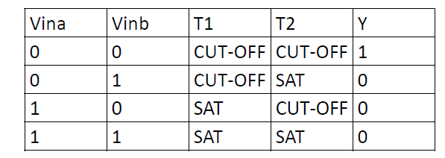
RTL--NOR
Notes:
5

Slide 6
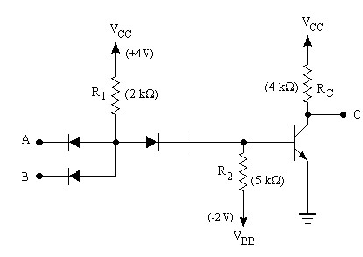

Diode-Transistor Logic (DTL)
essentially diode logic with transistor amplification
reduced power consumption
faster than RTL
=
A | B | NAND o/p
0 | 0 | 1
0 | 1 | 1
1 | 0 | 1
1 | 1 | 0
DL AND gate
inverter
6
Notes:
6
RTL had economic advantage in that very few transistors were used. It was important when transistors were expensive to make (more expensive than resistors). Such times have long past.

Slide 7
DTL-NAND
Input Diodes Da,Db,Dc conduct through resistor R, if the corresponding input is in the LOW state, while the corresponding to HIGH state the is non conducting.
If at least one of the input is LOW, the diode connected to their input conducts and the voltage at the output is one diode drop above the low level voltage at the input. this voltage keep the transistor in cut-off. The output of transistor is Vcc.
If all the three i/ps are in High state ,the i/p diodes are cut-off and current flowing from Vcc through R should be sufficient to drive transistor in saturation. Therefore the o/p of transistor is Vce(sat).
Voltage corresponds to logic 1 and logic 0 as Vcc and Vce(sat).
Delays are associated with the turning on and off of the output transistor.
While turning on, any capacitance shunting the output of the gate discharges rapidly through the low impedance of the o/p transistor in saturation
At turn off, the shunt capacitor must charge through the pull-up resistor Rc in addition to the storage time delay. Turn off delay is larger than turn on delay by a factor of 2 or 3.
Propagation delay of DTL gates are 30 to 80ns.
Notes:
7

Slide 8
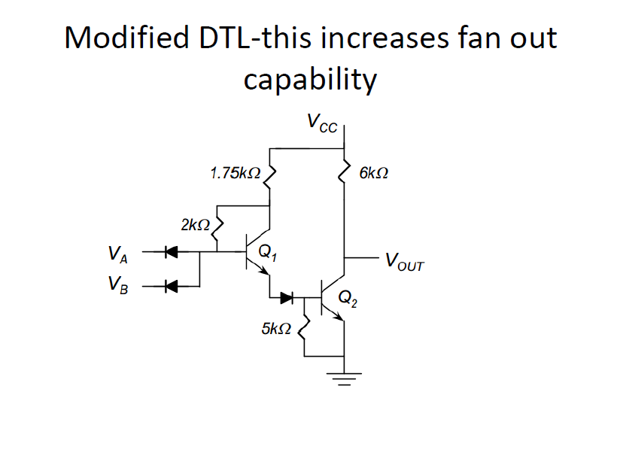
Notes:
8

Slide 9
TTL (Transistor-Transistor Logic)

Slide 10
Disadvantages of RTL & DTL
RTL :
Poor Noise Margin
Poor Fan out
Low Speed
High power dissipation
DTL :
Slow Speed
Improved noise margin & Fan out

Slide 11
TTL (Transistor-Transistor Logic)
The original basic TTL gate was a slight improvement over the DTL gate.
Introduced several TTL subfamilies or series
First introduced by in 1964 (Texas Instruments)
TTL has shaped digital technology in many ways
Transistor alone performs the logical operation & Logic gate operations
Transistors operated in saturated mode and cut off mode.
Fastest of the saturated logic families
Good speed
Low manufacturing cost
Wide range of circuits & applications
Availability in SSI & MSI
Relatively high power consumption

Slide 12
TTL (Transistor-Transistor Logic)
TTL subfamilies
Standard TTL
High speed TTL
Low power TTL
Schottky TTL
Low power Schottky TTL
Fast TTL
Three different types of output configurations
Open-collector output
Totem-pole output
Three-state (or tristate) output

Slide 13
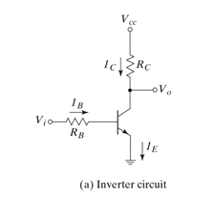
Transistor Operation
Ic = β*Ib
When Vin equals 1 (+5V), the transistor is turned on (saturation) and Vout equals 0 (0V).
When Vin equals 0 (0V), the transistor is turned off and Vout equals 1 (5V)

Slide 14
TTL(Transistor-Transistor Logic)
TTL can overcome disadvantages of RTL and DTL.
The basic gate was constructed with different resistor value to produce gate with lower dissipation or higher speed.
The propagation delay of a saturated logic family depends largely on storage time and RC time constants.
Reduce the storage time - decrease the propagation delay.
Reduce the resistor values in the circuit, decreases the time constant (RC) and decreases the propagation delay. But power dissipation is high due to lower resistance draw more current from the supply.
Speed of the gate is inversely proportional to propagation delay.
In low power TTL the resistor values are higher than standard TTL gate to reduce power dissipation, but increase propagation delay.
In high speed TTL resistor values are lowered to reduce the propagation delay but the power dissipation is increased.

Slide 15
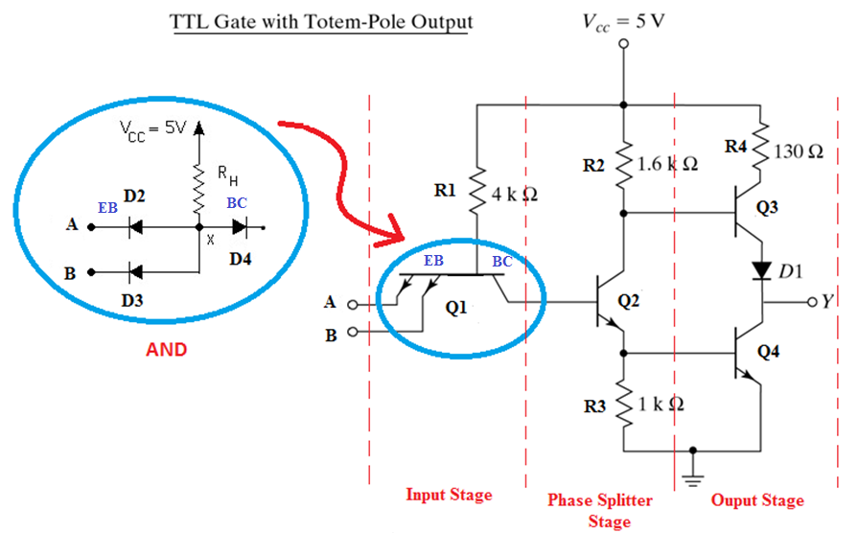
TTL Gate with Totem-Pole Output
Notes:
15

Slide 16
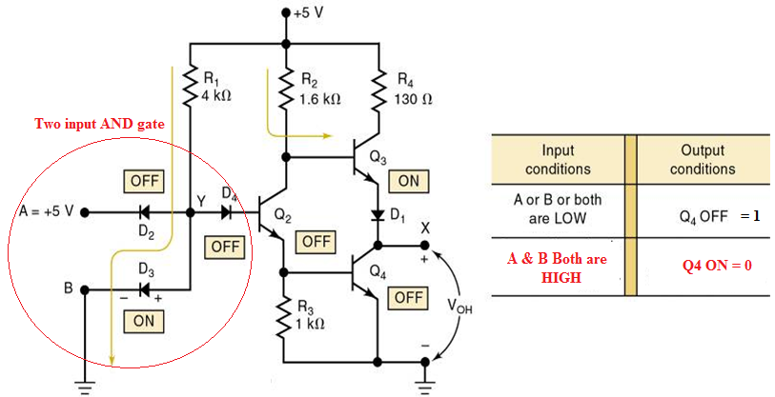
TTL – NAND Gate

Slide 17
TTL Gate with Totem-Pole Output
O/p impedance of the gate normally resistive &capacitive loads.
Capacitive load consist of capacitance of o/p transistor, capacitance of fan-out gates and any stray wiring capacitances.
When o/p changes from low to high, the o/p transistor of the gate goes from saturation to cut-off and the total load capacitance ‘C’ charges from low to high with time constant RC.
For open collector gate Rl=4kohm, c=15pf ,tpd=35ns. With active pull-up is replaced by passive pull-up circuit tpd is reduced to 10ns. This is called totem pole output.
When o/p Y=low, Q2&Q3 are in saturation. VcQ2=Vbe(Q3)+Vce(Q2)=0.7+0.2=0.9v, Vce(Q3)=0.2V
Q4 is cut-off bcos base of Q4 require 2*0..6=1.2V.

Slide 18
TTL Gate with Totem-Pole Output
When o/p Y=high, one of the i/p drops to low ,Q2&Q3 are in cut-off. o/p remains low bcos the voltage across the load capacitance cannot change instantaneously. As soon as Q2 turns off Q4 conducts bcos base is connected to Vcc through 1.6Kohm.
The current needed to charge the load ‘ C’ causes Q4 to saturate, o/p voltage rises with time constant RC.
R=130ohm+Rsat(Q4)+Rd~=150ohm less compare to passive pull up resistor, so transition from low to high is faster.
When C charges ,o/p voltage rises and current in Q4 decreases so Q4 comes to active region. Final o/p=5v-Vbedrop in Q4-D1 drop=3.6v Q3 goes cut-off very fast. But initial transition Both Q3 &Q4 are on ,peak ct’ is drawn from the supply. This ct’ spikes generates noise.
Change of state is frequent current spikes increases and PD also increases.
Wired connection is not allowed.

Slide 19
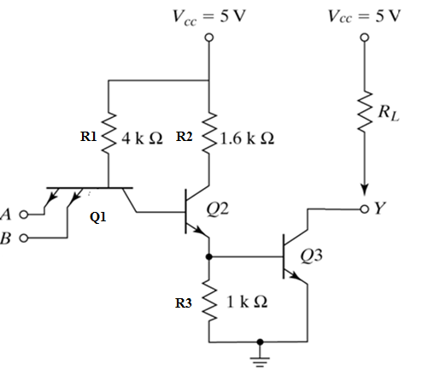
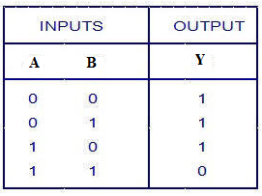
Open-collector TTL – NAND Gate
NAND Gate
Notes:
19

Slide 20
Open-collector TTL – NAND Gate
Multiple emitter of Q1 connected to i/ps. Compare to DTL ,i/p diodes--Q1, D1--B-C jn, D2—Q2.
o/p is taken from open collector of Q3.
Pull up resistor connected to Vcc, to pull up the o/p to high level when Q3 is off. Otherwise the o/p acts as an open circuit.
0.2v for low level,2.4 to 5v for high level.
If any i/p is low , corresponding B-E jn of Q1 is F.B. the voltage at base of Q1 is 0.9v(i/p 0.2+Vbe drop 0.7).
In order for Q3 to start conducting the path from Q1-Q3 must overcome the potential 1.8v (Diode drop in B-C jn drop+ two Vbe drop of Q2,Q3). But at Q1 is 0.9v so Q3 is cut-off , o/p is high.
If all i/ps are high Q2, Q3 conduct and saturate. B-E jns of Q1 are all R.B. when Q3 saturates o/p goes low to 0.2v.
Applications are driving a lamp or relay, performing wired logic and construction of common bus system

Slide 21
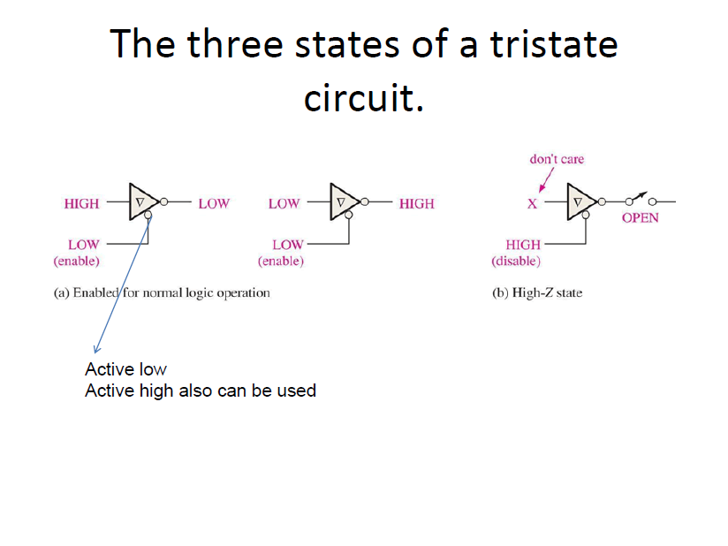

Slide 22
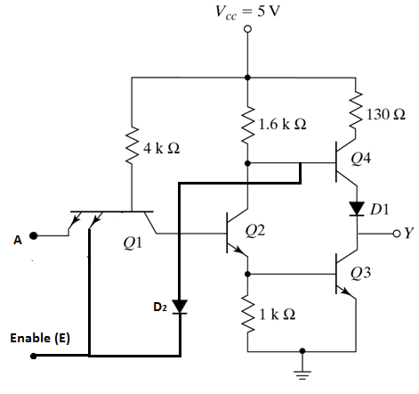
Three-state TTL with Inverter operation

Slide 23
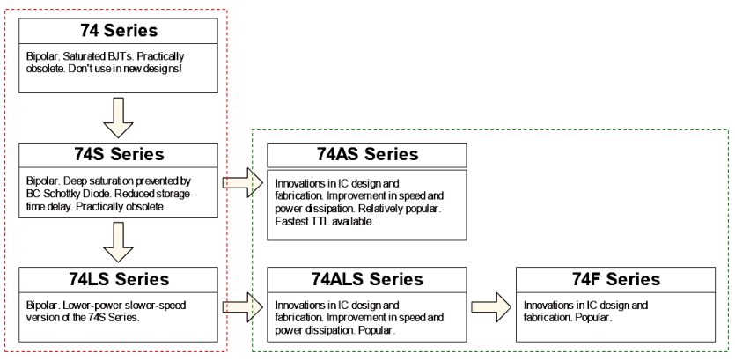
TTL family Evolution
Legacy: don’t use
in new designs
Widely used today

Slide 24
TTL (Transistor-Transistor Logic)
The original basic TTL gate was a slight improvement over the DTL gate.
Introduced several TTL subfamilies or series
First introduced by in 1964 (Texas Instruments)
TTL has shaped digital technology in many ways
Transistor alone performs the logical operation & Logic gate operations
Transistors operated in saturated mode and cut off mode.
Fastest of the saturated logic families
Good speed
Low manufacturing cost
Wide range of circuits & applications
Availability in SSI & MSI
Relatively high power consumption

